Slide 1
Programming Assignment 1 Star War Social Network Analysis

Slide 2
Dataset
The Star War dataset consists of the social network of Star War characters extracted from movie scripts
https://www.kaggle.com/ruchi798/star-wars
starwars-full-interactions-allCharacters.json
Contain the social network extracted from all episodes
The links between characters are defined by the times the characters speak within the same scene

Slide 3
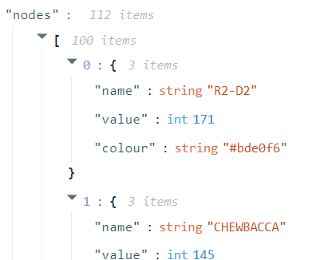
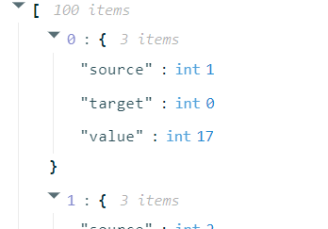
Dataset
112 nodes
Character name
The number of scenes the character appeared in
450 links
Undirected
Number of scenes where the two characters of the link appeared together

Slide 4
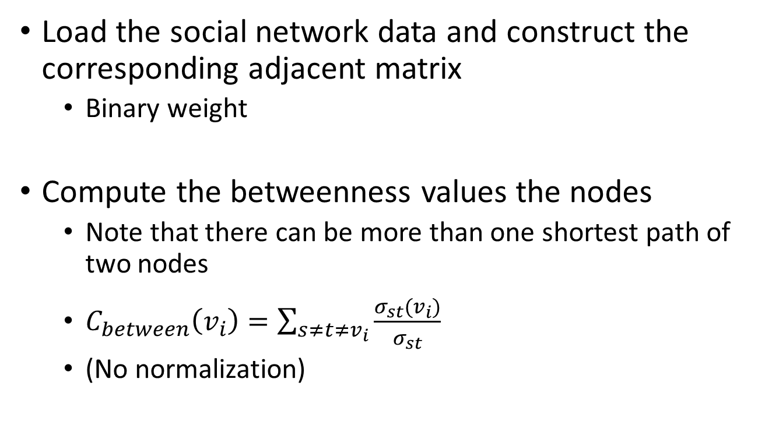

Task
the number of shortest paths
from node s to t

Slide 5
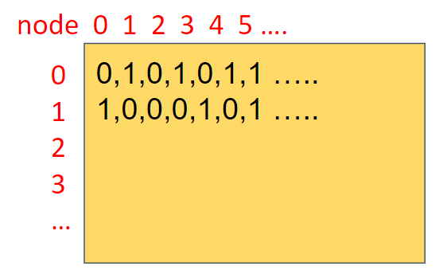
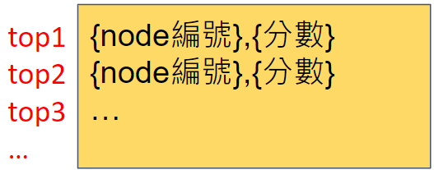
Output
紅色部分 header, index 為展示 column, row 用
繳交檔案請勿包含任何 header, index！
請繳交黃色方塊內的內容即可。
Save the adjacent matrix as a text file
e.g.
Show the top 10 betweenness characters
e.g.
Two weeks to do this programming assignment
matrix.csv
rank.csv

Slide 6
Grading
Matrix (30%)
Betweenness score and rank (30%)
Code and one-page report (40%)
No late submission will be accepted.
上傳的 matrix.csv 或 rank.csv 若格式有誤，則該項次不予計分。但可於一週內重新上傳結果與程式碼，分數會9折計算。（遲交者不適用）

